Slide 1
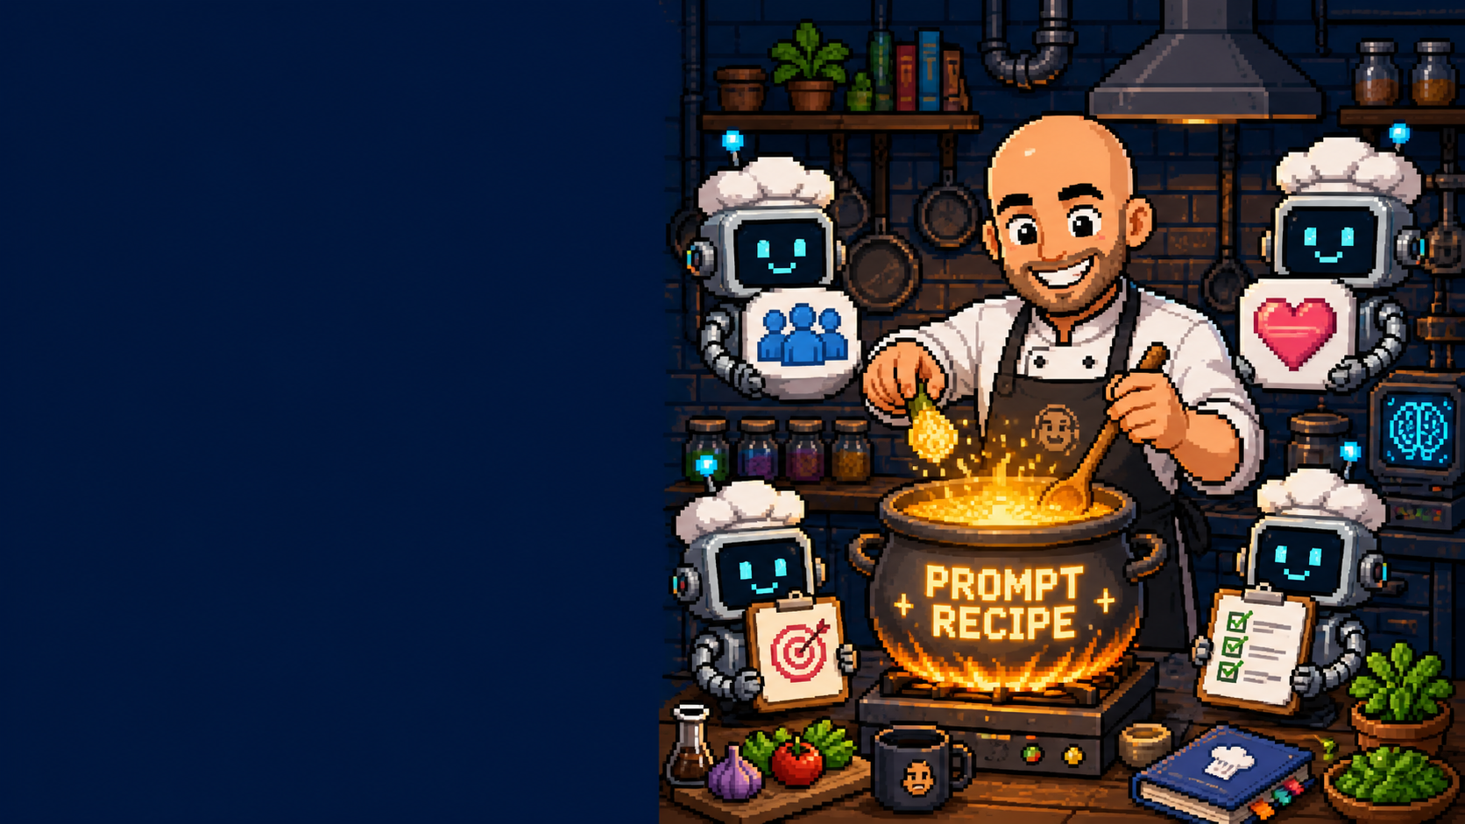
⚡ PUBLIC STARTER GUIDE
INTRO TO AI
INTRO TO AI
A practical session on saving time with drafts, lookups, notes, and follow-ups.
Today: find one repeat task AI can make less annoying.
No robot takeover. Just better tools for humans.
michaelcostea.com • AI Help • Intro to AI
Slide 1/19

Slide 2
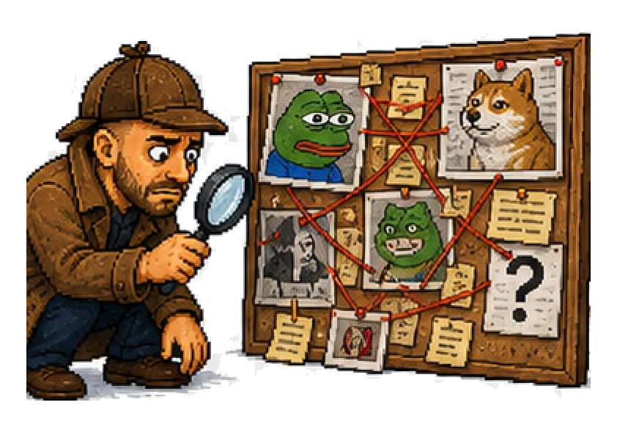
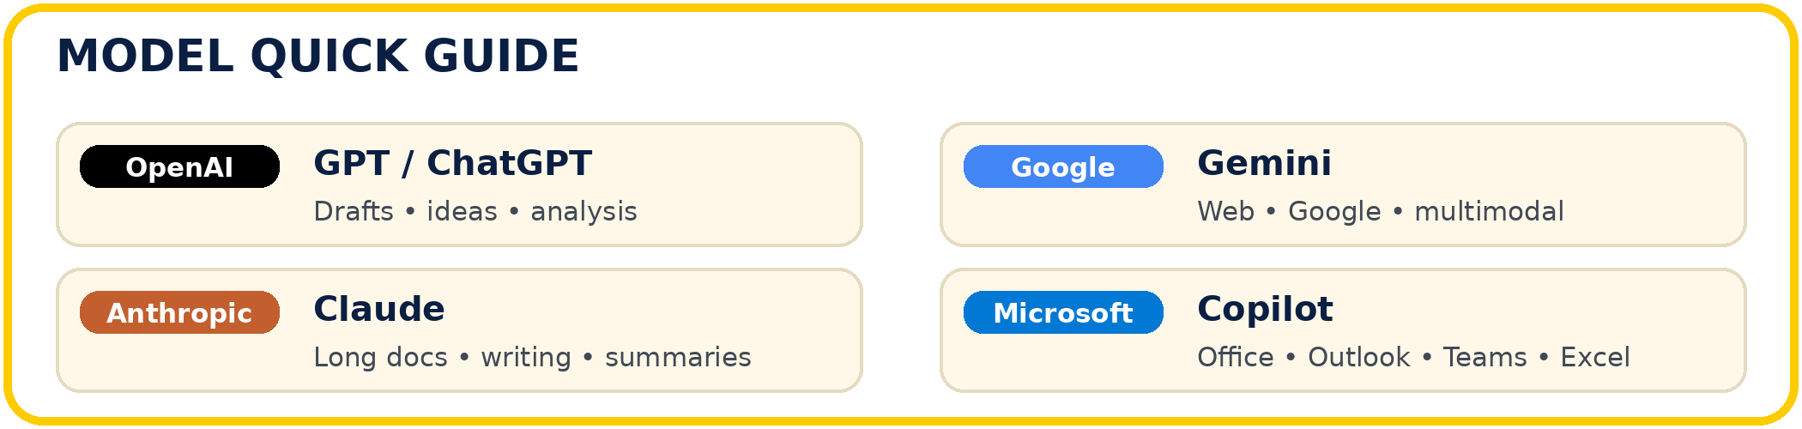
⚡ AI HELP
HOW TO ACCESS AI + LLMS
HOW TO ACCESS AI + LLMS
Use AI through web, mobile apps, built-in work tools, or API automation — then choose the model that suits the task.
🌐
Web + app access
💼
Work tools
Browser chat, phone apps, desktop apps, voice and image inputs.
Copilot, Google Workspace, CRM/helpdesk and document helpers.
🔌
API / automation
◎
ChatGPT / GPT
Connect forms, inboxes, workflow systems and repeat workflows.
OpenAI all-rounder: drafts, ideas, analysis and general problem solving.
TLDR;
Access is the doorway; the model is the engine. Pick the tool for the Work.
Choose access → choose model → ask clearly → check before using
michaelcostea.com • AI Help • Intro to AI
Slide 2/19

Slide 3
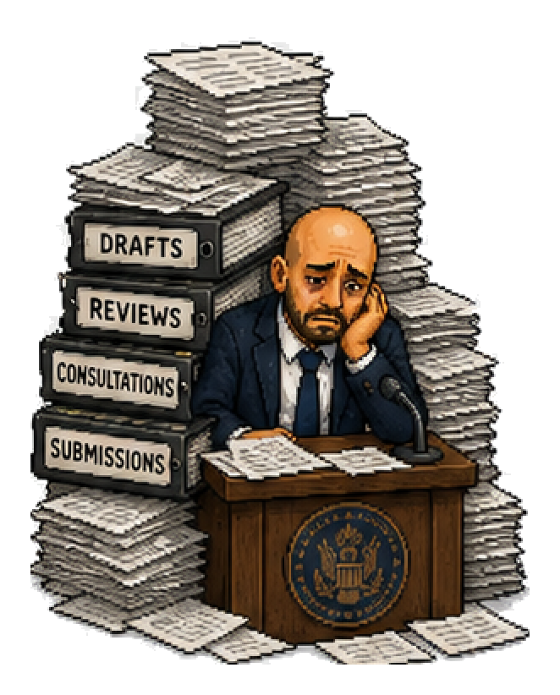
⚡ AI HELP
WHY SHOULD WE CARE?
WHY SHOULD WE CARE?
Long threads, messy notes, admin, and repeated explanations keep stealing time from real work.
minutes a day saved is real time back in your day — or off the clock.
20
minutes
a day
⚡
Fast answers
📄
Less paperwork
Customers expect clear updates on the spot.
Scope notes, checks, and follow-ups happen faster.
🔎
Quicker lookups
🧠
Better memory
TLDR;
Docs, specs, and product details without tab chaos.
The team captures what good looks like.
Small daily admin wins add up fast across the team.
You trained to solve real problems — not to spend your best years fighting messy PDFs.
Workflow: notes/docs → AI draft → human check → send
michaelcostea.com • AI Help • Intro to AI
Slide 3/19

Slide 4
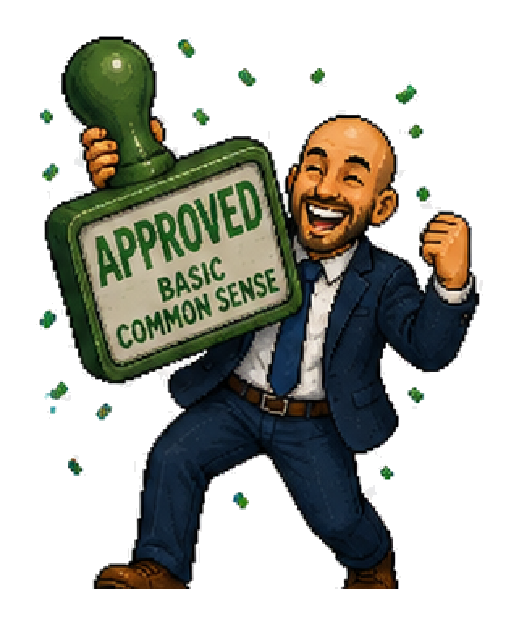
⚡ AI HELP
AI IN PLAIN ENGLISH
AI IN PLAIN ENGLISH
Think of AI as another tool in the kit.
🧮
Calculator
🔧
Power drill
helps with numbers
helps with physical work
✨
AI assistant
helps with language, information, planning
TLDR;
It is not magic. It still needs human common sense. Toolbelt, not autopilot.
AI is a helper for language, planning, and sorting info.
Workflow: notes/docs → AI draft → human check → send
michaelcostea.com • AI Help • Intro to AI
Slide 4/19

Slide 5
⚡ AI HELP
AI’S SWEET SPOT
AI’S SWEET SPOT
Best for repetitive brain work around the Work — not the safety-critical final call.
⚡
Repetitive brain work
📝
Site notes
draft • summarise • compare • structure
Clean customer updates
📚
Manuals + Docs
⚖️
Options
Quick practical takeaways
Compare scope, risks, next step
✅
Templates
TLDR;
Checklists and repeatable admin
Use AI for repeatable brain work, then check the result.
Workflow: notes/docs → AI draft → human check → send
michaelcostea.com • AI Help • Intro to AI
Slide 5/19

Slide 6
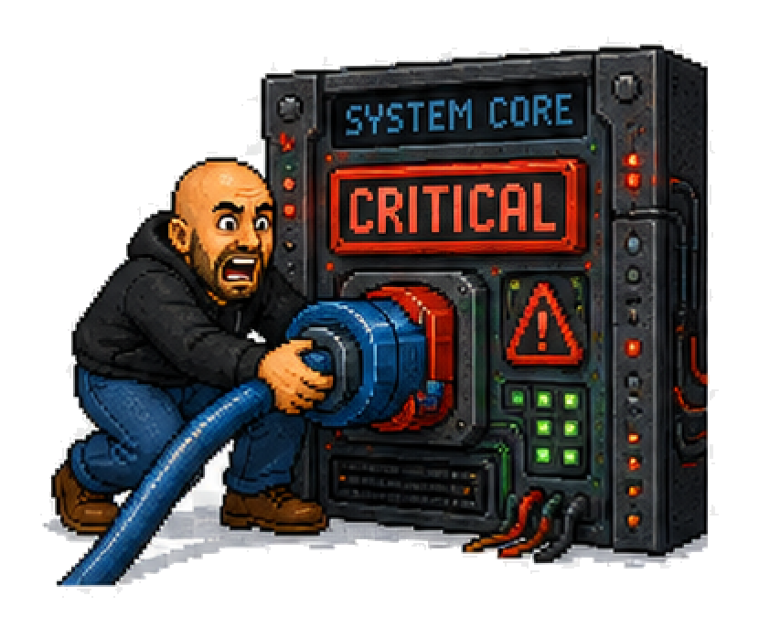
⚡ AI HELP
▣ FIELD TEAMS
FRONTLINE TEAMS, WHERE AI HELPS
FRONTLINE TEAMS, WHERE AI HELPS
⚡
Explain issues, options, recommendations, and next steps in plain English.
📘
Summarise supplier docs, policies, and requirements into a practical answer.
🧮
Check assumptions and missing details as a second-pass helper — not final authority.
📝
Turn notes into scope, exclusions, handovers, and customer updates faster.
TLDR;
✅
Create checklists, templates, and common troubleshooting guides.
Frontline teams can turn rough notes into clearer customer updates.
Ask: Summarise the key points and draft a customer explanation without jargon.
Workflow: notes/docs → AI draft → human check → send
michaelcostea.com • AI Help • Intro to AI
Slide 6/19

Slide 7
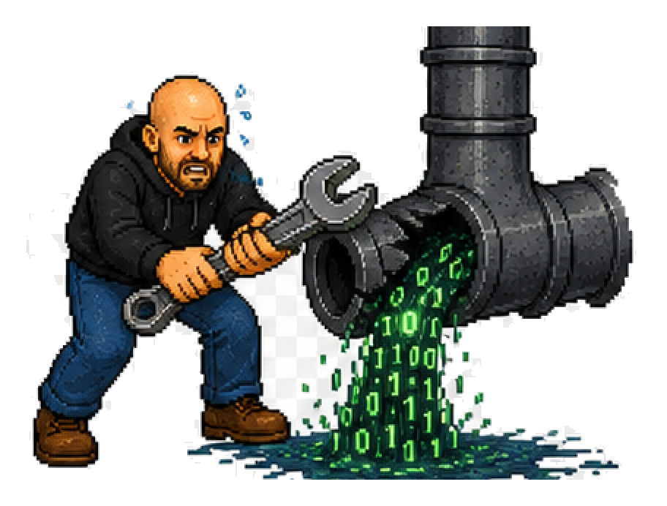
⚡ AI HELP
▣ CUSTOMER SUPPORT
CUSTOMER SUPPORT, WHERE AI HELPS
CUSTOMER SUPPORT, WHERE AI HELPS
Clear issue summaries, policy takeaways, and next-step options — without rewriting the same thing every day.
📸
Notes + context
💬
Customer explanation
issue summaries and handover notes
status, next steps, timing, ownership
📦
Documents + policies
🔧
Troubleshooting
turn long instructions into quick takeaways
checklists for common repeat problems
↩
Follow-up
TLDR;
notes and recommended next actions
Customer support teams can turn notes into simple next-step options.
Ask: Explain this issue simply, likely cause, and next-step options.
Workflow: notes/docs → AI draft → human check → send
michaelcostea.com • AI Help • Intro to AI
Slide 7/19

Slide 8

⚡ AI HELP
▣ OFFICE TEAM
OFFICE TEAM, WHERE AI HELPS
OFFICE TEAM, WHERE AI HELPS
Fewer tabs. Fewer copy-paste marathons. Fewer “who promised what to whom?” moments.
✉️
Draft email replies
🧵
Summarise threads
faster first pass
status, risks, next action
☎️
Call notes
🤝
Follow-ups
turn into action lists
polite, consistent reminders
📋
SOPs
TLDR;
first-pass process docs
Office work gets faster when long threads become clear actions.
Summarise this email chain into status, risks, and next action.
Workflow: notes/docs → AI draft → human check → send
michaelcostea.com • AI Help • Intro to AI
Slide 8/19

Slide 9

⚡ AI HELP
AI IN REAL WORKFLOWS
AI IN REAL WORKFLOWS
Goal: remove friction, not replace people.
→
Work notes → customer-ready updates
→
Inbox threads → clear next actions
→
Details → cleaner first drafts
→
Supplier docs → practical takeaways
→
Enquiries → faster triage
TLDR;
→
Common questions → consistent replies
Start with real real workflows: quotes, notes, inboxes, and triage.
Start with the Works we already repeat: updates, triage, notes, summaries, and follow-ups.
Workflow: notes/docs → AI draft → human check → send
michaelcostea.com • AI Help • Intro to AI
Slide 9/19

Slide 10
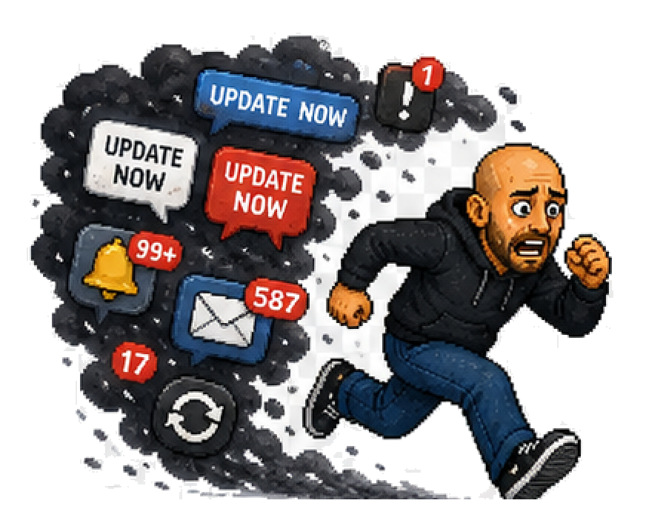
⚡ AI HELP
BEFORE AI VS AFTER AI
BEFORE AI VS AFTER AI
Same person. Same knowledge. Less stuffing around.
Before
After
finish work → scribble notes → dig through docs/manuals → rewrite update → send it late
dump notes into AI → draft update → quick summary → missing bits to check
admin grows after the work is done
human checks and sends
TLDR;
Work
→
Notes
→
Docs
→
Late
Notes
→
Draft
→
Check
→
Send
The win is faster drafts with a human final check.
Workflow: notes/docs → AI draft → human check → send
michaelcostea.com • AI Help • Intro to AI
Slide 10/19

Slide 11
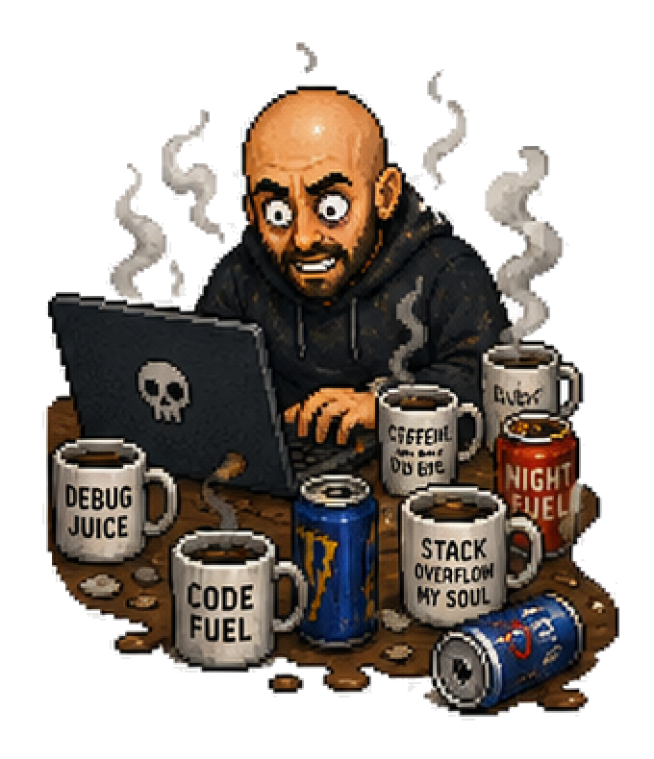
⚡ AI HELP
COULD AI HELP HERE?
COULD AI HELP HERE?
A quick test for annoying repeat work.
1
Do we do this often?
repeatable
2
Is it repetitive?
not one-off chaos
3
Notes, forms, emails, Docs, manuals, explanations?
language + information work
4
Does it slow handover, review, reporting, or updates?
TLDR;
friction hotspot
5
Do Good people keep wasting time here?
candidate for testing
If a task is repeatable and painful, it is worth testing.
Repeatable + annoying + time-consuming = worth testing
Workflow: notes/docs → AI draft → human check → send
michaelcostea.com • AI Help • Intro to AI
Slide 11/19

Slide 12
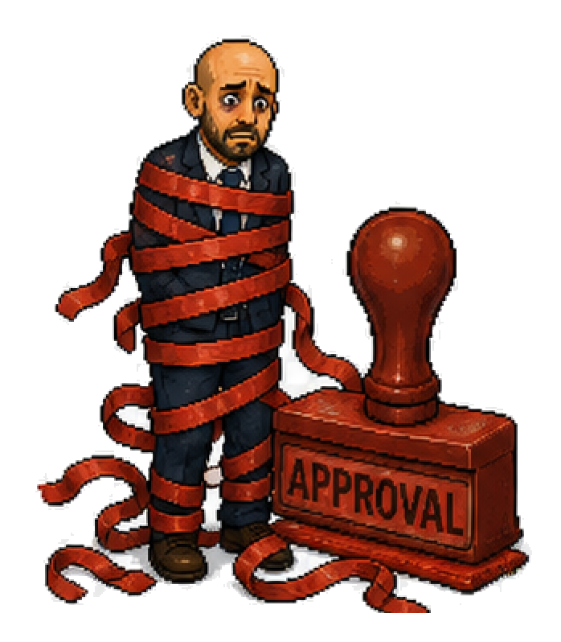
⚡ AI HELP
AUTOMATION OPPORTUNITY CHECKLIST
AUTOMATION OPPORTUNITY CHECKLIST
Automate the repetitive admin around the work — not the human responsibility itself.
✅
Good candidates
✨
Also good
Reminders, quote follow-ups, Work updates, product lookups, site notes.
Compliance summaries, repeated explanations, troubleshooting flows, handover notes.
⚠️
Bad candidates
🛠️
Rule of thumb
Final safety calls, legal/financial judgement, risky decisions, or one-off weird Works.
Automate weekly admin friction — not responsibility.
TLDR;
Automate admin friction, not human responsibility.
Workflow: notes/docs → AI draft → human check → send
michaelcostea.com • AI Help • Intro to AI
Slide 12/19

Slide 13

⚡ AI HELP
SAFETY + PRIVACY
SAFETY + PRIVACY
Don’t be that person.
!
Don’t trust outputs blindly.
!
Don’t paste sensitive info into random tools.
!
Don’t fake knowledge you do not have.
!
Don’t let AI send final customer comms without approved review.
TLDR;
Workflow: notes/docs → AI draft → human check → send
Privacy and human review are non-negotiable.
If you give AI chaos, it will confidently return deluxe chaos.
michaelcostea.com • AI Help • Intro to AI
Slide 13/19

Slide 14
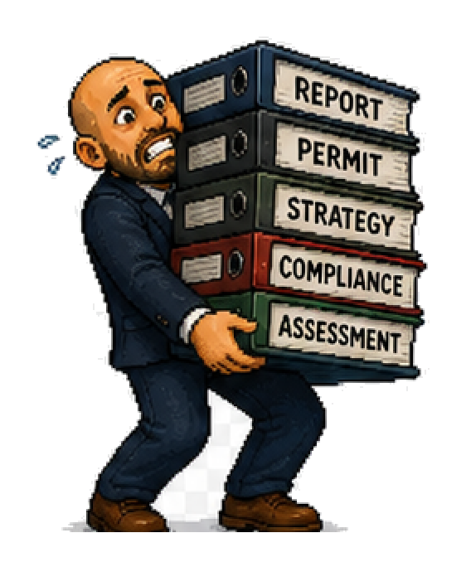
⚡ AI HELP
GOOD PROMPTS BEAT BAD PROMPTS
GOOD PROMPTS BEAT BAD PROMPTS
Better instructions get better output.
✕
Bad
✓
Better
Write email
Write a short friendly email to a customer explaining an issue, why it matters, and recommended next steps this week. Keep it simple and non-alarmist.
Prompt recipe
TLDR;
Task
Audience
Tone
Must include
Avoid
Specific prompts beat vague prompts every time.
Workflow: notes/docs → AI draft → human check → send
michaelcostea.com • AI Help • Intro to AI
Slide 14/19

Slide 15

⚡ AI HELP
▣ OPPORTUNITY SPOTTING
YOU’LL SPOT OPPORTUNITIES WE WON’T
YOU’LL SPOT OPPORTUNITIES WE WON’T
Best ideas come from people doing the real work every day.
→
We keep sending the same explanation.
→
This form takes too long.
→
We re-enter the same info in three places.
→
We always chase the same missing details.
TLDR;
The best automation ideas come from people doing the work.
If you think “surely there’s a better way”, we want to hear it.
Workflow: notes/docs → AI draft → human check → send
michaelcostea.com • AI Help • Intro to AI
Slide 15/19

Slide 16

⚡ AI HELP
▣ HANDOFF PATH
Bring ideas to the workflow owner
Bring ideas to the workflow owner
Include the basics so the idea is easy to test.
TASK
what the task is
OWNER
who does it now
FREQUENCY
how often it happens
PAIN
what makes it painful
OUTCOME
what good would look like
TLDR;
We do [task] [how often]. It takes about [time]. The annoying part is [pain]. I think AI or automation could help by [idea].
A useful idea only needs task, owner, frequency, pain, outcome.
Workflow: notes/docs → AI draft → human check → send
michaelcostea.com • AI Help • Intro to AI
Slide 16/19

Slide 17

⚡ AI HELP
IF WE DO THIS RIGHT…
IF WE DO THIS RIGHT…
The win is not using AI. The win is getting work done better.
Better work, less friction
⚡
Faster internal workflows
⚡
Better customer communication
⚡
Less time on repeat admin
⚡
More consistency across team responses
TLDR;
⚡
Better capture of team knowledge
⚡
More time for higher-value work
Better work means less repeat admin and clearer communication.
Workflow: notes/docs → AI draft → human check → send
michaelcostea.com • AI Help • Intro to AI
Slide 17/19

Slide 18

⚡ AI HELP
▣ NEXT STEPS
LET’S BUILD THIS TOGETHER
LET’S BUILD THIS TOGETHER
Try it. Question it. Test boring tasks first. Share what works. Tell us what is painful.
→
Bring ideas to the workflow owner
→
No robot takeover. Just better tools for humans.
→
If it saves time, reduces friction, and helps us do better work, it’s worth testing.
TLDR;
Test boring tasks first, then keep what saves time.
Workflow: notes/docs → AI draft → human check → send
michaelcostea.com • AI Help • Intro to AI
Slide 18/19

Slide 19

⚡ AI HELP
OPTIONAL DISCUSSION PROMPTS
OPTIONAL DISCUSSION PROMPTS
→
What should AI fix first?
→
What task wastes the most time each week?
→
What customer explanation do we keep repeating?
→
What regulation, spec, or product info is annoying to look up?
→
What admin step should happen automatically after work is completed?
TLDR;
→
Where are we double-handling information today?
Use the questions to pick the first practical automation target.
Workflow: notes/docs → AI draft → human check → send
michaelcostea.com • AI Help • Intro to AI•
Slide 19/19

